Slide 1
Abrar Khan
Manu Kuchhal
September 05, 2014
Product Implementation Training (PIT)
IBM Case Manager v5.2.1
Upgrade Scenario 1
Upgrade from IBM Case Manager v5.2

Slide 2
Introduction
Course Overview
  This session covers the upgrade scenarios from ICM 5.2 to 5.2.1
Target Audience:
  IBM Case Manager Support Teams (L2,L3)
  ECM Lab Services
  IBM GBS and GTS
  Technical Sales
Prerequisites:
  Working knowledge of ICM 5.2, Content Navigator 2.0.2, and FileNet P8 5.2 architecture and implementation
Version Release Date: September, 2014
© Copyright International Business Machines Corporation 2014. All Rights Reserved.
US Government Users Restricted Rights - Use, duplication or disclosure restricted by GSA ADP Schedule Contract with IBM Corp.

Slide 3
Course Objectives
After this course you will be able to:
Understand the Case Manager upgrade process
Perform software upgrades of IBM Case Manager Development, Test and Production Environments
Migrate existing IBM Case Manager environments to new hardware as part of the upgrade process
Perform Solution and Template upgrades using Case Manager Builder
Understand the Best Practices guidelines pertaining to upgrades

Slide 4
Course Roadmap
  High Level Upgrade Roadmap
      Environment Upgrade
          Use existing hardware
          Move to new hardware
      Solution Upgrade
      Best Practices
      Course Summary

Slide 5
High Level Upgrade Roadmap
1
Prepare existing Development, Test/UAT, and Production environments
2
Upgrade existing environments
3
Configure upgraded environments
4
Upgrade solutions
5
Migrate and deploy upgraded solutions to Test/UAT environments
6
Migrate and deploy validated solutions to Production

Slide 6
Course Roadmap
      High Level Upgrade Roadmap
      Environment Upgrade
          Use existing hardware
          Move to new hardware
      Solution Upgrade
      Best Practices
      Course Summary

Slide 7
Environment upgrade – Prepare existing environments
The following operations must be performed on all existing Case Manager 5.2 environments before starting the upgrade process:
Download and install the following fix packs from IBM Support Fix Central:
  Content Platform Engine 5.2.0 Fix Pack 3 (Release Date: Mar 12, 2014)
  Content Platform Engine 5.2.0.3 Interim Fix 3 (Release Date: Sep 05, 2014)
  WorkplaceXT 1.1.5.2 Interim Fix 1 (Release Date: Dec 23, 2013)
  Case Manager 5.2.0 Fix Pack 1 ¹ (Release Date: Dec 20, 2013)
  Content Navigator 2.0.2 Fix Pack 4 (Release Date: Jun 13, 2014)
Backup (full backup recommended) your existing environments
Notes:
Although upgrades from 5.2.0 (GA), 5.2.0.1 and 5.2.0.1 iFix 2 to 5.2.1 are fully supported, it is recommended to apply the latest fix pack before doing the upgrade.

Slide 8
Development Environment upgrade – Existing hardware
Reuse existing WebSphere profile / WebLogic domain and FileNet P8 Object Stores
Install and configure Content Navigator 2.0.3
Install and configure Case Manager 5.2.1
Update all existing Case Manager applications (deployed in WebSphere / WebLogic) to version 5.2.1
Upgrade business solutions using Case Builder
Deploy and test upgraded business solutions
Design Object Store
WebSphere / WebLogic
Project Area
Solution v5.2
Case Builder
Case Builder 5.2.1
5. Upgrade
Solution v5.2.1
Target Object Store
6a. Deploy
Case Client 5.2.1
Workflow System
6b. Test
Solution v5.2.1
Solution v5.2

Slide 9
Development Environment upgrade – Existing hardware
Case Manager configuration tool
Create an Development Upgrade profile and execute these tasks
Required tasks:
Update the Content Platform Engine Client Connector files
Note: The Case Manager configuration tool must be restarted after executing this task
Configure the Case Management Object Stores
Note: Run this task against all Target Object Stores
Create Case Manager Applications
Deploy the Case Manager API
Register the IBM Case Manager Services Plug-in
Deploy Workplace XT ¹
Deploy Case Manager Builder
Deploy the Case Manager Help System
Deploy and Register Widgets Package ³
Register the IBM Case Manager Administration Client Plug-in
Register Project Area ⁴
Note: Run this task for all Project Areas
Optional tasks
Deploy the Forms Application ²
Configure Business Rules
Register the External Data Service
Deploy and Register Extensions Package
Notes:
The Deploy WorkplaceXT task must be executed to include the updates for the multi-user editing feature.
If the business solutions contain eForms or IBM Forms, the Deploy Forms Applications task must be executed
The Deploy and Register Widgets Package task needs to be executed only if the new widget features e.g., Custom Property Editor, etc, are required
Restart the WebSphere/WebLogic application server after all tasks have been executed

Slide 10
Test/Production Environment upgrade – Existing hardware
Reuse existing WebSphere profile / WebLogic domain and FileNet P8 Object Stores
Install and configure Content Navigator 2.0.3
Install and configure Case Manager 5.2.1
Update existing Case Manager applications (deployed in WebSphere / WebLogic) to version 5.2.1
Import upgraded business solutions from the Development environment
Deploy and validate upgraded business solutions
Staging Object Store
WebSphere / WebLogic
Solution v5.2
5. Import
Case Builder
Solution v5.2.1
Case Manager Administration Client 5.2.1
6a. Deploy
Case Client 5.2.1
Workflow System
6b. Validate
Solution v5.2.1
Solution v5.2
Target Object Store

Slide 11
Test/Production Environment upgrade – Existing hardware
Case Manager configuration tool
Create a Production Upgrade profile and execute these tasks
Required tasks:
Update the Content Platform Engine Client Connector files
Note: The Case Manager configuration tool must be restarted after executing this task
Configure the Case Management Object Stores
Note: Run this task against all Target Object Stores
Create Case Manager Applications
Deploy the Case Manager API
Register the IBM Case Manager Services Plug-in
Deploy the Case Manager Help System
Deploy and Register Widgets Package ²
Register the IBM Case Manager Administration Client Plug-in
Register Target Environment ³
Note: Run this task for all Target Environments
Optional tasks:
Deploy the Forms Application ¹
Configure Business Rules
Register the External Data Service
Deploy and Register Extensions Package
Notes:
If the business solutions contain eForms or IBM Forms, the Deploy Forms Applications task must be executed
The Deploy and Register Widgets Package task needs to be executed only if the new widget features e.g., Custom Property Editor, etc, are required
Restart the WebSphere/WebLogic application server after all tasks have been executed

Slide 12
Development Environment upgrade – Move to new hardware
Install and configure FileNet P8 5.2 + latest fix packs and WorkplaceXT 1.1.5.2 on new hardware
Note: Configure JDBC Data Sources to point to existing GCD and object store databases ¹
Install and configure Content Navigator 2.0.3
Install and configure Case Manager 5.2.1
Import, configure and deploy any custom widgets and/or custom components
Upgrade business solutions using Case Builder 5.2.1
Deploy and test business solutions in the new environment
Case Manager 5.2.1
Design Object Store
Custom Widgets/ Components
Target Object Store
4. Import
Solution v5.2
Workflow System
Solution v5.2
Solution v5.2.1
6a. Deploy
Solution v5.2.1
5. Upgrade
6b. Test
Case Builder 5.2.1
Case Client 5.2.1
Notes:
During the initial setup and configuragtion, it is a best practice to point to copies of the GCD and object store databases.
If the object stores use File Storage Areas, make sure you configure the new environment to point to the existing storage locations.
Before deploying the FileNetEngine EAR file in the new environment, you must transfer the encryption keys from the EAR file in the existing environment. Alternately, you can copy the entire EAR file from the existing environment and deploy it using the FieNet Configuration Manager.

Slide 13
Development Environment upgrade – Move to new hardware
Create a Development profile using the Case Manager configuration tool and execute these tasks
NOTE: Reuse the same network shared directory that was used in the ICM 5.2 environment ^{1,2}
Required tasks:
Update the Content Platform Engine Client Connector files
Note: The Case Manager configuration tool must be restarted after executing this task
Configure the Case Management Object Stores
Note: Run this task against all Target Object Stores
Create Case Manager Applications
Deploy the Case Manager API
Register the IBM Case Manager Services Plug-in
Deploy Workplace XT ³
Deploy Case Manager Builder
Deploy the Case Manager Help System
Deploy and Register Widgets Package
Register the IBM Case Manager Administration Client Plug-in
Register Project Area ⁵
Note: Run this task for all Project Areas
Optional tasks:
Deploy the Forms Application ⁴
Configure Business Rules
Register the External Data Service
Deploy and Register Extensions Package
Notes:
If the network shared directory from the ICM 5.2 environment is not accessible from the new ICM 5.2.1 hardware, then create a new directory. However, all existing 5.2 business solutions must be re-deployed and all custom widgets packages must be re-deployed and re-registered. The Deploy and Register Widgets Package needs to be executed for both the OOTB widgets and all custom widget packages.
The network shared directory cannot be shared with any other instance of ICM.
The Deploy WorkplaceXT task must be executed to deploy the re-built EAR file which includes support for multi-user editing in Case Builder.
If the business solutions contain eForms or IBM Forms, the Deploy Forms Applications task must be executed
Restart the WebSphere/WebLogic application server after all tasks have been executed

Slide 14
Test/Production Environment upgrade – Move to new hardware
Install and configure FileNet P8 5.2 + latest fix packs on new hardware
Note: Configure JDBC Data Sources to point to existing GCD and object store databases ¹
Install and configure Content Navigator 2.0.3
Install and configure Case Manager 5.2.1
Import, configure and deploy any custom widgets and/or custom components
Export upgraded business solutions from Case Manager 5.2.1 Development environment
Import business solutions into new Case Manager 5.2.1 environment
Deploy and validate business solutions in the new environment
Case Manager 5.2.1 Development Environment
Case Manager 5.2.1 Test/Production Environment
Custom Widgets/ Components
4. Import
Staging Object Store
Target Object Store
Design Object Store
Workflow System
Solution 5.2.1
Solution 5.2
Upgraded Solution
5. Export
Solution Package
Solution 5.2
Solution 5.2.1
Upgraded Solution
6. Import
7. Deploy
Notes:
During the initial setup and configuragtion, it is a best practice to point to copies of the GCD and object store databases.
If the object stores use File Storage Areas, make sure you configure the new environment to point to the existing storage locations.
Before deploying the FileNetEngine EAR file in the new environment, you must transfer the encryption keys from the EAR file in the existing environment. Alternately, you can copy the entire EAR file from the existing environment and deploy it using the FieNet Configuration Manager.

Slide 15
Test/Production Environment upgrade – Move to new hardware
Create a Production profile using the Case Manager configuration tool and execute these tasks
NOTE: Reuse the same network shared directory that was used in the ICM 5.2 environment ^{1,2}
Required tasks:
Update the Content Platform Engine Client Connector files
Note: The Case Manager configuration tool must be restarted after executing this task
Configure the Case Management Object Stores
Note: Run this task against all Target Object Stores
Create Case Manager Applications
Deploy the Case Manager API
Register the IBM Case Manager Services Plug-in
Deploy the Case Manager Help System
Deploy and Register Widgets Package
Register the IBM Case Manager Administration Client Plug-in
Register Target Environment ⁴
Note: Run this task for all Target Environments
Optional tasks:
Deploy the Forms Application ³
Configure Business Rules
Register the External Data Service
Deploy and Register Extensions Package
Notes:
If the network shared directory from the ICM 5.2 environment is not accessible from the new ICM 5.2.1 hardware, then create a new directory. However, all existing 5.2 business solutions must be re-deployed and all custom widgets packages must be re-deployed and re-registered. The Deploy and Register Widgets Package needs to be executed for both the OOTB widgets and all custom widget packages.
The network shared directory cannot be shared with any other instance of ICM.
If the business solutions contain eForms or IBM Forms, the Deploy Forms Applications task must be executed
Restart the WebSphere/WebLogic application server after all tasks have been executed

Slide 16
Course Roadmap
  High Level Upgrade Roadmap
      Environment Upgrade
          Use existing hardware
          Move to new hardware
      Solution Upgrade
      Best Practices
      Course Summary

Slide 17
Solution Upgrade – Using Case Builder
Solution Upgrade from ICM 520 to ICM 521
Solution Template upgrade from ICM 520 to ICM 521

Slide 18
Solution upgrade 5.2 to 5.2.1
Upgrade from ICM 5.2 to ICM 5.2.1 involves few changes in Solution definition file
  Modify the schema version: <sdf:schemaVersion>3.1</sdf:schemaVersion>
  Modify the product version: <sdf:productVersion>5.2.1</sdf:productVersion>

Slide 19
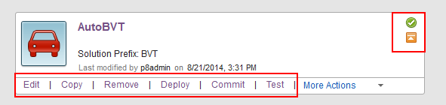
Overview of Solution Upgrade using Case Builder.
Assumptions,
  The solution is
    Already exported from a 5.2.0 project area and imported into a 5.2.1 project area
    In the same or a different P8 domain
  The 5.2.0 environment has already been upgraded to 5.2.1
In 5.2.1 Case Builder,
  5.2.0 solutions are identified by a distinct orange icon
  The solution prefix is not empty
  Actions for Copy, Deploy, Commit and Test are enabled
Notes:
Bit confused by this page – not sure what the connection of the bottom set of bullets is with the assumptions. Are you saying that after I've upgraded the Case Manager software, but not yet upgraded the solution, then this is what I'll see....or something else?
<Manu>Yes that is right. Solution is not yet upgraded to 5.2.1. The box below explains the characteristics of a 5.2.0 solution visible in CB 5.2.1. To make it clear, I made second bullet as “In 5.2.1 Case Builder”.
The solution prefix not being empty and the actions enabled with Orange icon is a clear distinction from 5.1.1 solution. For 5.1.1 solution the prefix is empty and some of these actions are disabled. Its covered separately for 5.1.1 solution upgrade.</Manu>

Slide 20
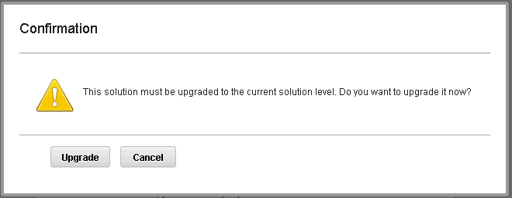
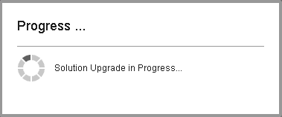
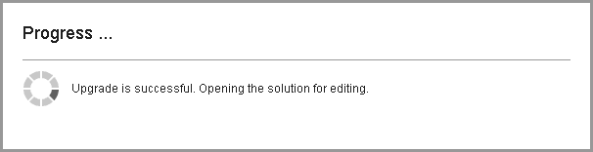
Overview of Solution Upgrade using Case Builder.
A click on Edit action for a 5.2.0 solution throws open the option to Upgrade.
Once the user chooses to Upgrade, there are system prompts that keep user informed about the progress.

Slide 21
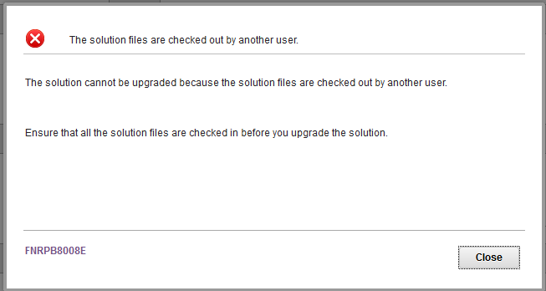
Exception handling for upgrade failure
When a user chooses to Upgrade a Solution, while other user has locked the Solution definition file SDF, error message will be shown to the user

Slide 22
Solution Template Upgrade
Only ICM 5.2.0 solution template can be upgraded to ICM 5.2.1 template. Other versions of template are not supported.
During 5.2.0 solution template upgrade, only solution definition file, schema version and product version is updated to 3.1 and 5.2.1 respectively.
Template upgrade is done only through Case Builder
Template upgrade is done when a 5.2.0 solution template is selected to create solution from it.

Slide 23
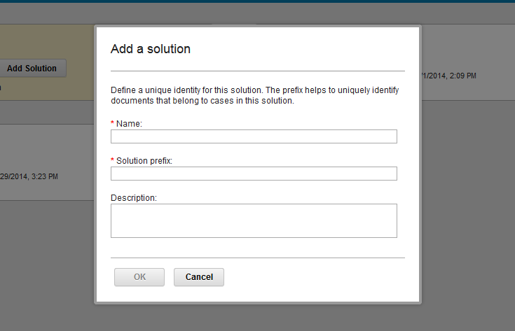
Solution template upgrade
It is assumed that 5.2.0 Solution template is already exported from a 5.2.0 project area and imported into a 5.2.1 project area ¹
Enter solution name and prefix and click OK.
Notes:
This statement is to communicate that chosen template is from older 5.2.0 version. It may have come in 5.2.1 environment perhaps by an import action.

Slide 24
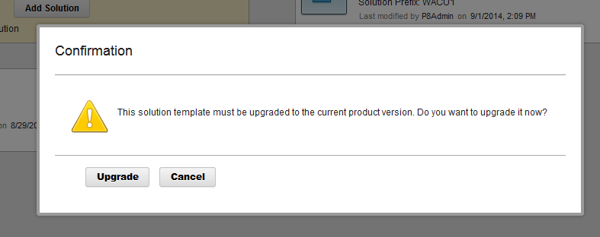
Solution template upgrade
A prompt will be shown to confirm user action on upgrading the template from 5.2.0 to 5.2.1

Slide 25
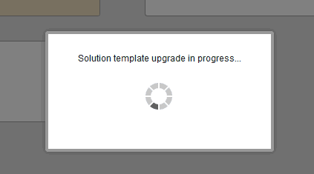
Solution template upgrade
Solution template upgrade is in progress

Slide 26
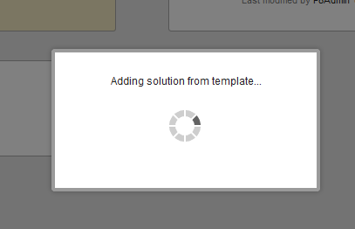
Solution template upgrade
When upgrade is successful, solution gets created from the upgraded 5.2.1 solution template and 5.2.1 solution gets opened soon after solution is created

Slide 27
Course Roadmap
  High Level Upgrade Roadmap
      Environment Upgrade
          Use existing hardware
          Move to new hardware
      Solution Upgrade
      Best Practices
      Course Summary

Slide 28
Best Practices
Environment and solution backups
  Always perform a full backup of the Case Manager environment after applying the latest fix packs and before starting the upgrade process.
  Business solutions and all related artifacts should also be exported and backed-up before the upgrade.
Network Shared Directory
  Always use a SAN/NAS/NFS location as the network shared directory.
  The network shared directory should never be shared with any other instance of Case Manager.
Deploying custom widgets and extensions packages
  To deploy and register custom widget packages and extensions packages, use these Case Manager configuration tool tasks:
    Deploy and Register Widgets Package
    Deploy and Register Extensions Package

Slide 29
Best Practices
Version control business solutions
  When migrating business solutions between environments e.g., Development to Test / Production, it is recommended to version control the solution package and all other related artifacts.
Exporting business solutions
  Don't export business solutions from a Test / UAT environment when migrating to Production
  Always use the solution exported from the Development environment to migrate a solution to Production

Slide 30
Course Roadmap
  High Level Upgrade Roadmap
      Environment Upgrade
          Use existing hardware
          Move to new hardware
      Solution Upgrade
      Best Practices
      Course Summary

Slide 31
Course Summary
You have completed this course and can:
Perform software upgrades of IBM Case Manager Development, Test and Production Environments
Migrate IBM Case Manager environments to new hardware as part of the upgrade process
Perform Solution and Template upgrades using Case Manager Builder
Follow the Best Practices guidelines pertaining to upgrades

Slide 32
Contacts
Product Marketing Manager:
    William D. (Doc) Mills (wdocmills@us.ibm.com)
Product Manager:
    Dave Perman (dperman@ca.ibm.com)
Subject Matter Experts (SME)/Area of Expertise:
    Manu Kuchhal (manukuchhal@in.ibm.com)
    Paul Mac Alpine (psmacalp@us.ibm.com)
    Steven Hsieh (shsieh@us.ibm.com)
    Abrar Khan (abrakhan@us.ibm.com)
Product Support Manager:
    Ted Dullanty (tdullanty@us.ibm.com)

Slide 33
Product Help/Documentation/Resources
IBM Case Manager 5.2.1 Knowledge Center: http://www-01.ibm.com/support/knowledgecenter/SSCTJ4_5.2.1/com.ibm.casemgmttoc.doc/casemanager_5.2.1.htm?lang=en
IBM Case Manager 5.2 Knowledge Center:http://www-01.ibm.com/support/knowledgecenter/SSCTJ4_5.2.0/com.ibm.casemgmttoc.doc/casemanager_5.2.0.htm?lang=en
IBM Content Navigator 2.0.3 Knowledge Center:http://www-01.ibm.com/support/knowledgecenter/SSEUEX_2.0.3/contentnavigator_2.0.3.htm
IBM FileNet P8 5.2 Knowledge Center: http://www-01.ibm.com/support/knowledgecenter/SSNW2F_5.2.0/com.ibm.p8toc.doc/filenetcontentmanager_5.2.0.htm?lang=en
IBM Support: Fix Central http://www-933.ibm.com/support/fixcentral/
ECM Learner Portal:
http://eb90.elearn.ihost.com/wps/portal/ibm
IBM FileNet Content Manager and IBM Case Foundation V5.2 Product Implementation and Maintenance Training (PIT/PMT) (220234)
IBM Case Manager V5.2 Product Implementation and Maintenance Training (PIT/PMT) (220246)

